Slide 1
Telecom Churn EDATelecom Churn EDA Telecom Churn EDA
CAPSTONE PROJECT
Presented By:
PR.SINGARAM
SHANMUGANATHAN ENGINEERING COLLEGE

Slide 2
OUTLINE
Problem Statement
Proposed System/Solution
System Development Approach
Algorithm & Deployment
Result
Conclusion
Future Scope
References

Slide 3
Problem Statement
Telecom churn analysis is the process of identifying customers who are likely to cancel their service or switch to a different service provider. This is an important problem for telecom companies, as churn can have a significant impact on their revenue and profitability.
Orange S.A., formerly France Télécom S.A., is a French multinational telecommunications corporation. The Orange Telecom's Churn Dataset, consists of cleaned customer activity data (features), along with a churn label specifying whether a customer canceled the subscription. Explore and analyze the data to discover key factors responsible for customer churn and come up with ways/recommendations to ensure customer retention.

Slide 4
Proposed Solution
Modify International Plan as the charge is same as normal one.
Be proactive with communication.
Ask for feedback often.
Periodically throw Offers to retain customers.
Look at the customers facing problem in the most churning states.
Lean into best customers.
Regular Server Maintenance.
Solving Poor Network Connectivity Issue.
Define a roadmap for new customers.
Analyze churn when it happens.
Stay competitive.

Slide 5
System Approach
Churn Analysis:
Identified the number of churned customers and their churn rate.
Analyzed churn rates based on different area codes.
Statistical Analysis:
Calculated statistical values (mean, median) for each feature grouped by area code.
Churn Analysis by State:
Analyzed churn counts for each state.
Churn Analysis by Plans:
Analyzed churn rates based on whether customers have an International plan or Voice mail plan.
Investigated churn rates for customers with both International and Voice mail plans, only International plan, only Voice mail plan, and neither plan.

Slide 6
Algorithm & Deployment
Churn Rate: The churn rate was calculated, showing that approximately 14.49% of customers have churned, while 85.51% have not.
Churn Rate by Area Code: Churn rates were analyzed based on area codes, revealing variations in churn rates across different area codes.
Statistical Analysis by Area Code: Mean and median values of various features were calculated for each area code, providing insights into the distribution of data within different regions.
Churn Analysis by State: Churn counts were examined for each state, shedding light on which states have higher churn rates.
Churn Analysis by International Plan: Churn rates were analyzed based on whether customers have an international plan or not, revealing differences in churn rates between these groups.

Slide 7
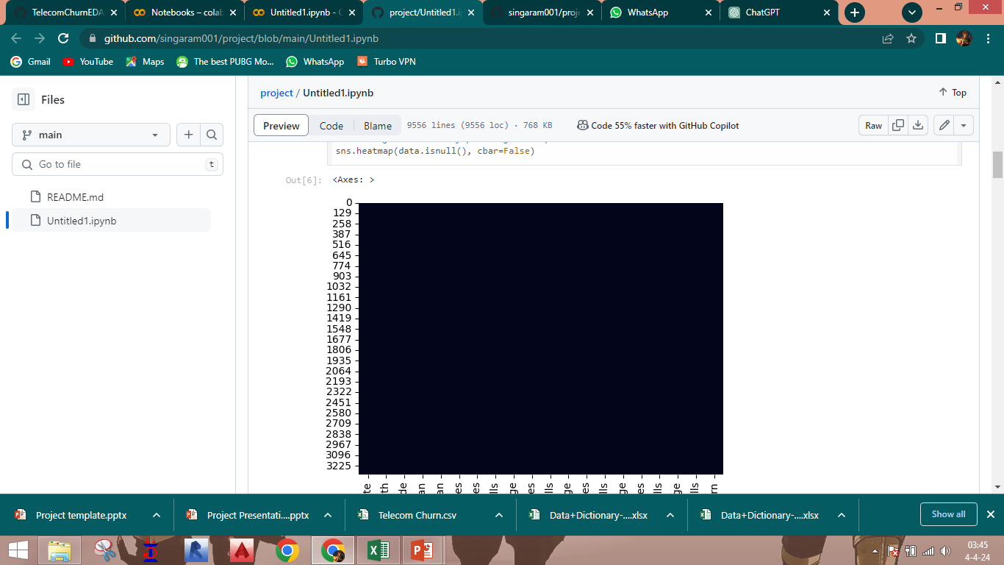
Result

Slide 8
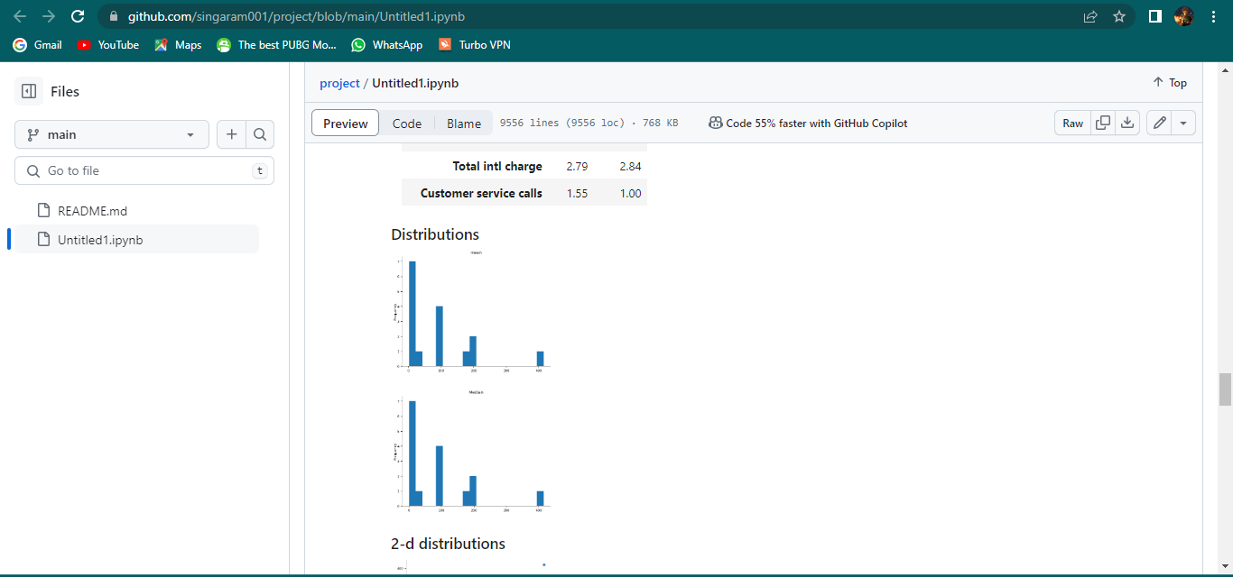
Result

Slide 9
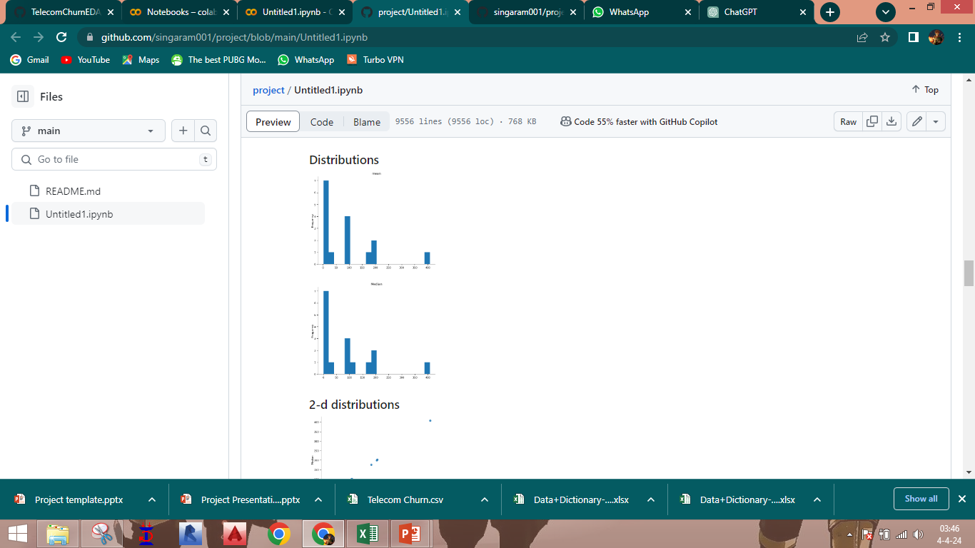
Result

Slide 10
Conclusion
The four charge fields are directly related to the minute fields.
The area code may not be relevant and can be excluded.
Customers with the International Plan tend to churn more often.
Customers who have had four or more customer service calls churn significantly more than other customers.
Customers with high day and evening minute usage tend to churn at a higher rate.
There is no clear relationship between churn and the variables such as day calls, evening calls, night calls, international calls, night minutes, international minutes, account length, or voice mail messages

Slide 11
Future scope
Predictive Modeling: Build predictive models to forecast customer churn based on historical data and identify factors influencing churn.
Customer Segmentation: Segment customers based on their behavior, usage patterns, and demographics to tailor retention strategies for different segments.
Feature Engineering: Create new features or derive insights from existing features to improve model performance and enhance understanding of churn drivers.
Feedback Analysis: Analyze customer feedback and complaints data to identify pain points and areas for improvement in products or services.
Real-time Monitoring: Implement real-time monitoring systems to detect early signs of potential churn and trigger proactive retention strategies.

Slide 12
References
https://github.com/yahya-ansariii/TelecomChurnEDA
https://colab.research.google.com/drive/1sLvn3Ty2eEu5Baafh7KQV6VkPAjYWVzG?authuser=0#scrollTo=H5PkSit-52mx
https://github.com/singaram001/project
PPT using Microsoft office

Slide 13
THANK YOU

